Slide 1

Computer Architecture and Assembly Language Presentation
Sagar Chhabriya

Slide 2
Computer Mathematics

Slide 3

Topics
Integer Representation
Integer Arithmetic
Floating point representation
Floating point arithmetic

Slide 4
CPU & GPU
A Central Processing Unit (CPU) is the brain of your computer.
Whose is job is to Carry out a diverse set of instructions
A Graphics Processing Unit (GPU) is a specialized processor
Whose job is to rapidly manipulate memory

Slide 5
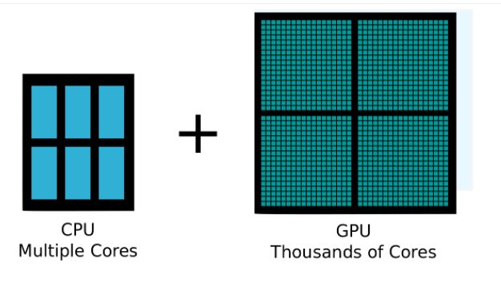

Slide 6
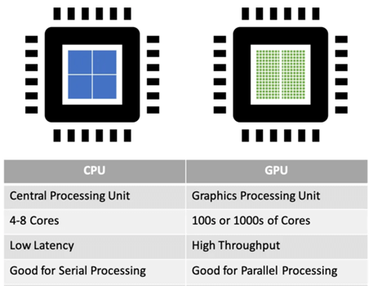

Slide 7

Let’s dive into computer Math.

Slide 8
Integer Representation, including:
Sign and modulus
One’s complement
Two’s complement
Representation of Fractions
Floating point or real.
IEEE

Slide 9
What is Integer Representation About?
Let’s understand how computers handle integers.
Ex:
●
●
●
How are negative numbers represented? How are floating point numbers represented?
Processing – How do we add, subtract,…?

Slide 10

How can we represent a binary number?
??????
Maybe
NO
- 000111001

Slide 11
How can we represent a binary number?
Binary number can only be represented by a 0 or 1, so we cannot use a (-) to denote a negative number.
Therefore, we cannot use a specialized symbol so it must be either a 0 or 1.
There are THREE methods used, they are:
Sign and Modulus/Magnitude
One’s Complement
Two’s Complement

Slide 12
Sign and Modulus
This method uses the far left-hand bit which is often referred to as the sign bit.
The general rule is that a positive number starts with 0 and a negative number starts with a 1.
+ 28 = 0 001 1100
SIGN
Modulus

Slide 13
ACTIVITY 1
Using ONE byte what is the maximum positive and negative integer that can represented using sign and modulus?
Convert the following numbers to binary using sign and modulus.
●
●
●
122
-100
-264

Slide 14
One’s Complement
What is a complement?
It is the opposite of something.
Because computers do not like to subtract, this method finds the complement of a positive number and then addition can take place.
-127
-75
0
75
127

Slide 15
ACTIVITY 2
1. Convert the following binary numbers into a negative using one’s complement.
0011 0111₂
0011 00112

Slide 16
Two’s Complement
Two's complement is a binary representation method for both positive and negative integers, obtained by flipping all bits and adding 1 to the result.
The process for two’s complement is the same as one’s complement, however, you are then required to add 1 to the results.

Slide 17
Two’s Complement
Example
Find the two’s complement of +15₁₀
●
●
●
Convert +15₁₀ to binary. Swap all the bits.
Add 1 to the result.

Slide 18
Two’s Complement
Example
●
●
+15 = 00001111₂
00001111₂
11110000₂
●
11110000₂
+1
11110001

Slide 19
Two’s Complement
Rules for Adding
1 + 1 = 0 (Carry the 1)
0 + 0 = 0
0 + 1 = 1

Slide 20
ACTIVITY 3
1. Convert the following binary numbers into a negative using two’s complement.
●
●
●
00101110₂
01101000
2
01011011₂
●
A computer has a word length of 8 binary digits and uses two’s complement.
Translate -82₁₀ into a form a computer would use.

Slide 21
Answers
00101110 - 11010010
01101000 - 10011000
01011011 - 10100101

Slide 22
ANSWER
●
●
Translate 82₁₀ into binary = 01010010₂
Reverse all the bits so that 0’s become 1’s and 1’s become 0’s.
10101101 = -82₁₀ in one’s complement. Complete two’s complement.
Answer = 10101110₂
●
●
●

Slide 23
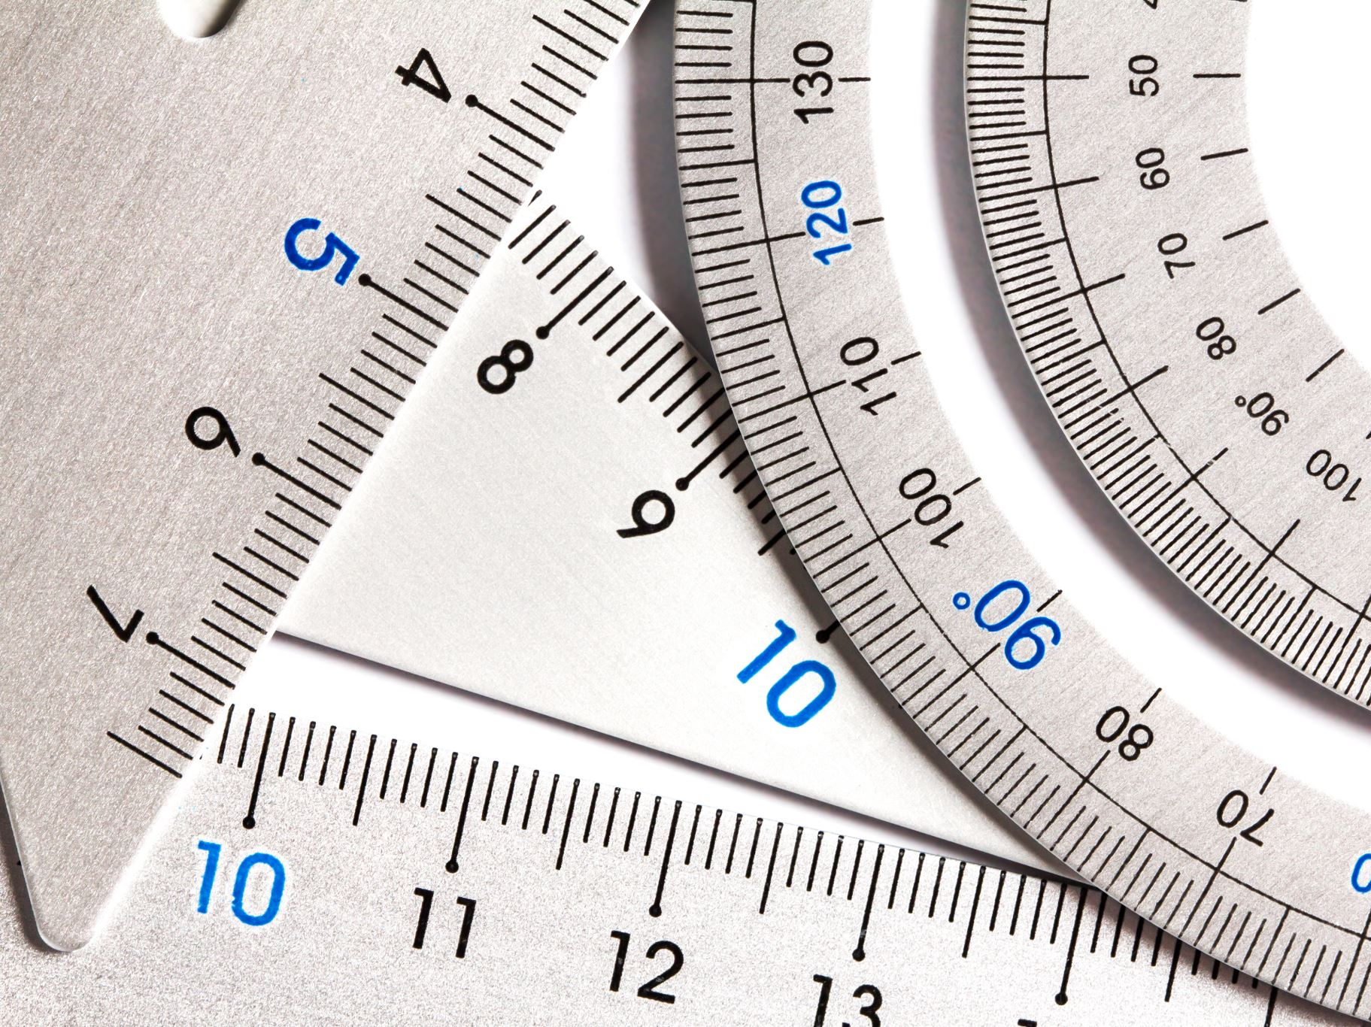
Fractions

Slide 24
Representation of Fractions
What are they?
Fractional numbers are numbers between 0 and 1.
They are called real numbers in computing terms.
Real numbers contain both an integer and fractional part.
E.g. 23.714 OR 01101.1001

Slide 25

Methods Used:
Computers use two main methods to represent real numbers:
They are:
●
●
Fixed point Floating point

Slide 26
Fixed Point
This method assumes the decimal point is in a fixed position.
Relies on using a fixed number of bits for both the integer and fractional parts
i.e. 5 and 3.
Example
10011101 = 10011.101

Slide 27
Fixed Point
Integer |  |  |  |  | Fractional
16 | 8 | 4 | 2 | 1 | 0.5 | 0.25 | 0.125
1 | 0 | 0 | 1 | 1 | 1 | 0 | 1
Therefore
16 + 2 + 1 = 19 (Integer)
0.5 + 0.125 = 0.625 (Fraction)
So 10011.101 = 19.625

Slide 28

Fixed Point
Problems are:
You fix the numbers that you can represent
i.e. you are limited to amount of numbers that you can actually represent.

Slide 29
Activity 4
Convert the following binary numbers to decimal.
a. 101.11
b. 110.101
Convert the following decimal numbers to binary.
a. 2.25
b. 0.875

Slide 30
Answers
a. For 2.25:
2 * 2 = 4 → 1 (integer part) - first bit from left to right
0.25 * 2 = 0.5 → 0
0.5 * 2 = 1.0 → 1
0 (since there's no fractional part anymore)
So, 2.25 in binary is 10.01.

Slide 31
Answers
b. For 0.875:
0 * 2 = 0 → 0
0.875 * 2 = 1.75 → 1
0.75 * 2 = 1.5 → 1
0.5 * 2 = 1.0 → 1
0 (since there's no fractional part anymore)
So, 0.875 in binary is 0.111.

Slide 32
Activity 4
1. Identify what number 11001101 would represent in the integer /fractional ratio:
a. 6:2
b. 5:3
c: 4:4
Notes:
To identify what number 11001101 represents in the integer/fractional ratio, we need to divide the binary number into two parts based on the given ratio. Let's analyze each case:
a. For the ratio 6:2:
The first 6 digits represent the integer part, and the remaining 2 digits represent the fractional part.
Integer part: 110011
Fractional part: 01
Converting these parts to decimal:
Integer part: 110011 in binary is 51 in decimal.
Fractional part: 01 in binary is 1/4 in decimal.
Combining both parts:
Integer part: 51
Fractional part: 1/4
So, the number represented by 11001101 in the ratio 6:2 is 51 + 1/4 = 51.25.
b. For the ratio 5:3:
The first 5 digits represent the integer part, and the remaining 3 digits represent the fractional part.
Integer part: 11001
Fractional part: 101
Converting these parts to decimal:
Integer part: 11001 in binary is 25 in decimal.
Fractional part: 101 in binary is 5/8 in decimal.
Combining both parts:
Integer part: 25
Fractional part: 5/8
So, the number represented by 11001101 in the ratio 5:3 is 25 + 5/8 = 25.625.
c. For the ratio 4:4:
The first 4 digits represent the integer part, and the next 4 digits represent the fractional part.
Integer part: 1100
Fractional part: 1101
Converting these parts to decimal:
Integer part: 1100 in binary is 12 in decimal.
Fractional part: 1101 in binary is 13/16 in decimal.
Combining both parts:
Integer part: 12
Fractional part: 13/16
So, the number represented by 11001101 in the ratio 4:4 is 12 + 13/16 = 12.8125.
In summary:
a. 6:2 ratio represents 51.25.
b. 5:3 ratio represents 25.625.
c. 4:4 ratio represents 12.8125.

Slide 33
Answers
a. For the ratio 6:2:
The first 6 digits represent the integer part, and the remaining 2 digits represent the fractional part.
Integer part: 110011
Fractional part: 01
Converting these parts to decimal:
Integer part: 110011 in binary is 51 in decimal.
Fractional part: 01 in binary is 1/4 in decimal.
Combining both parts:
Integer part: 51
Fractional part: 1/4
So, the number represented by 11001101 in the ratio 6:2 is 51 + 1/4 = 51.25.

Slide 34
Answer
b. For the ratio 5:3:
The first 5 digits represent the integer part, and the remaining 3 digits represent the fractional part.
Integer part: 11001
Fractional part: 101
Converting these parts to decimal:
Integer part: 11001 in binary is 25 in decimal.
Fractional part: 101 in binary is 5/8 in decimal.
Combining both parts:
Integer part: 25
Fractional part: 5/8
So, the number represented by 11001101 in the ratio 5:3 is 25 + 5/8 = 25.625.

Slide 35
Answer
c. For the ratio 4:4:
The first 4 digits represent the integer part, and the next 4 digits represent the fractional part.
Integer part: 1100
Fractional part: 1101
Converting these parts to decimal:
Integer part: 1100 in binary is 12 in decimal.
Fractional part: 1101 in binary is 13/16 in decimal.
Combining both parts:
Integer part: 12
Fractional part: 13/16
So, the number represented by 11001101 in the ratio 4:4 is 12 + 13/16 = 12.8125.

Slide 36
Floating Point
This is the preferred method because you can represent large numbers.
This uses exponential notation which highlights two specific parts of a decimal number:
●
●
Mantissa – Fractional part.
Exponent – Is the power by 10 which the mantissa is multiplied.

Slide 37
Floating Point
Example
●
●
●
floating-point representation aims to show how many numbers are before or after the decimal point.
Left and Right Hand Rule.
-241.65 | = | -0.24165 x 10³
0.0028 | = | 0.28 x 10⁻²
110.11 | = | 0.11011 x 2³

Slide 38
Fixed VS Floating
Fixed Point Numbers | Floating Point Numbers
Limited precision | Higher precision
Constant number of decimal places | Variable number of decimal places
Suitable for applications requiring consistent precision | Suitable for scientific calculations, engineering, and simulations
Simple implementation | More complex implementation
Limited range of values | Wider range of values
More efficient for integer operations | More efficient for real number operations
Examples: Currency values, percentages | Examples: Scientific measurements, financial modeling

Slide 39
Thank You!
RADHE RADHE

